Slide 1
Concentration Polarization of LDL
in the Arterial System
Governing Equations, Boundary Conditions & Computational Model
Fatouraee, Deng, De Champlain & Guidoin | Ann. N.Y. Acad. Sci., 1998

Slide 2
Model Assumptions, COMSOL Parameters & Modules
Assumptions
COMSOL Parameters
Homogeneous, incompressible, Newtonian blood
Straight cylindrical vessel, uniform diameter
Vessel wall permeable to LDL (V_{w} ~ 10⁻⁶ cm/s)
Pulsatile inlet: Womersley velocity profile
Uniform inlet LDL concentration (C = C₀)
Name
Value
Description
R₀
0.0035 m
Internal radius of artery
L
0.035 m
Length of segment (10·R₀)
ρ_{b}
1050 kg/m³
Density of blood
μ_{b}
0.0035 Pa·s
Dynamic viscosity
D
5E-12 m²/s
Diffusion coefficient
Vw
4E-8 m/s
Filtration velocity
COMSOL Modules
Q
275 ml/min
Flow rate
Laminar Flow (spf) — fluid flow solver
c₀
1 mol/m³
Inlet concentration
f
70 /min
Heart rate
Transport of Diluted Species (tds) — LDL mass transport
T
0.857 s
Cardiac period (1/f)

Slide 3
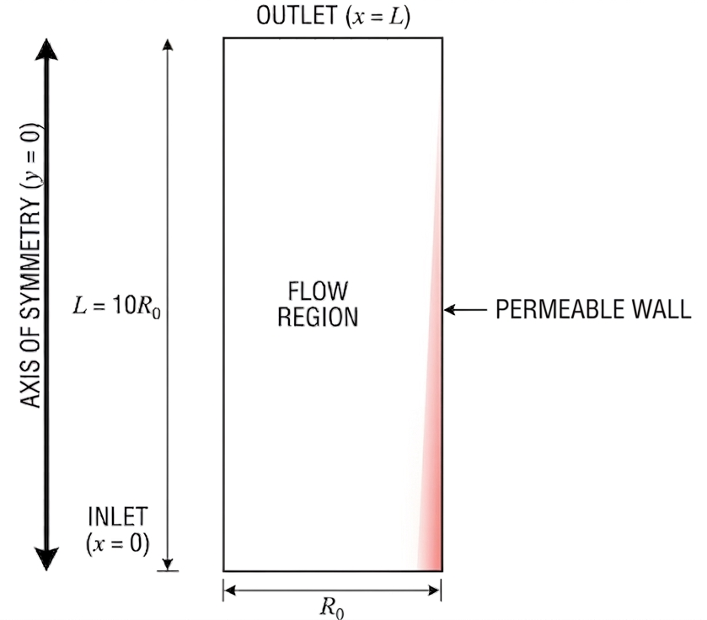
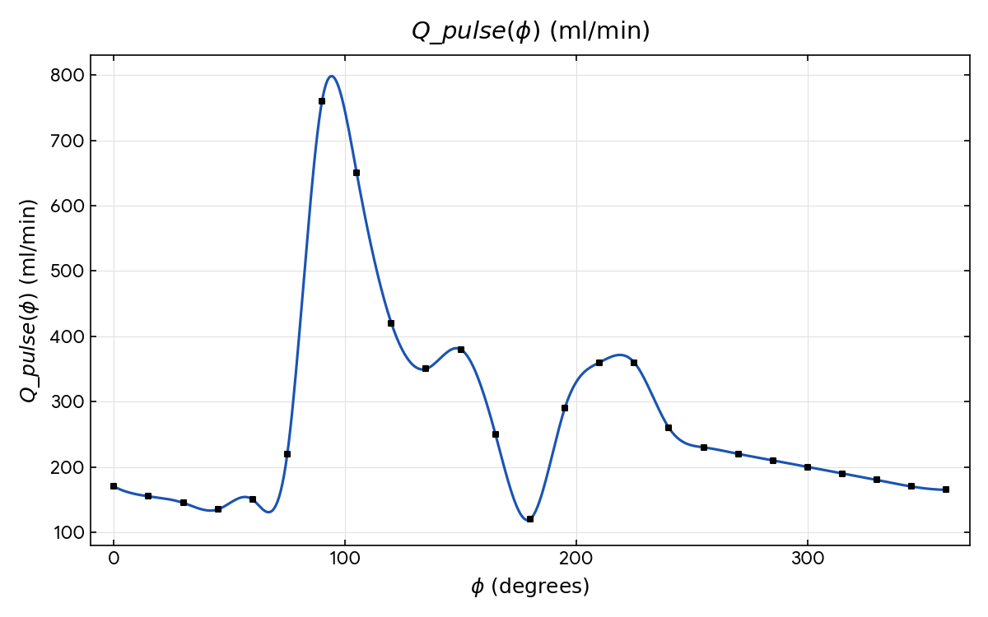
Geometry
Geometry
Inlet Flow Rate Profile

Slide 4




Governing Equations
Fluid Flow Equations
(Laminar Flow)
Navier-Stokes Equation
$$ρ\left(u∙∇\right)u= ∇∙\left[−pI+K\right]+F$$
Continuity Equation
$$ρ∇∙u=0$$
p = static pressure | I = identity tensor | K = viscous stress tensor | F = body force vector field
Convection-Diffusion
Equation
Mass Transport Equations
(Transport of Diluted Species)
$$∇∙J_{i}+u∙∇c_{i}= R_{i}$$
Fick’s Diffusion Law
$$J_{i}= {−D}_{i}∇c_{i}$$
J = diffusive flux | R = reaction rate term

Slide 5
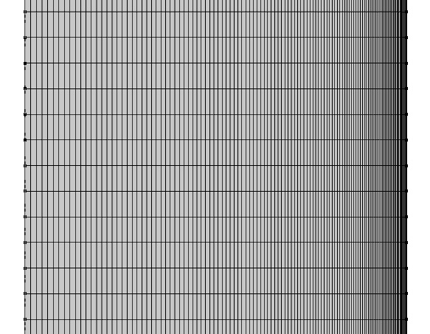
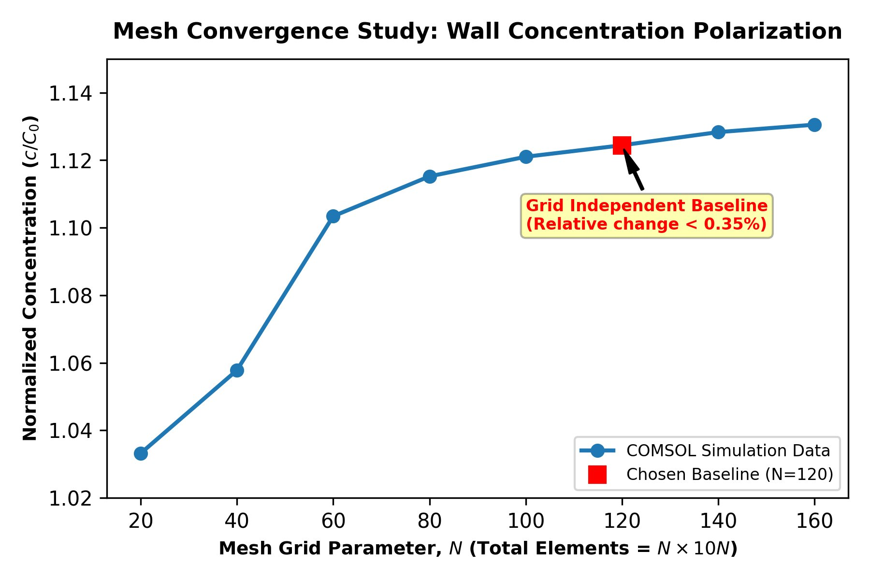
Grid Independent Study
Grid Independent Mesh (N = 120)
Grid Independence Study
Baseline Selection: N = 120
Relative change from N = 120 to N = 160 < 0.35%
120 x 1200 elements ; refined at the wall

Slide 6




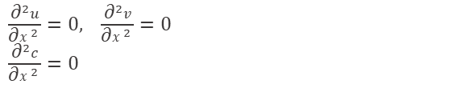
Boundary Conditions
Location
Condition
Equation
Vessel wall
(no-slip)
No-slip axial velocity
Radial velocity = Vw / ū₀
$u\left(x,1,t\right)=0$
$v\left(x,1,t\right)= \frac{V_{w}}{\overline{u0}}$
Inlet
(x = 0)
Womersley pulsatile velocity
Uniform LDL concentration
$u\left(0,y,t\right)= u_{wm}, v\left(0,y,t\right)=0$
$c\left(0,y,t\right)=1$
Axis of
symmetry
Streamline; zero vorticity
Zero radial conc. gradient
$v\left(x,0,t\right)=0$
$\frac{\text{∂}u}{\text{∂}y}=0, \frac{\text{∂}c}{\text{∂}y}=$0
Outlet
(x = 10R₀)
Extrapolation condition
(no upstream reflection)
$\frac{{\text{∂}}^{2}u}{{\text{∂}x}^{2} }=0,$ $\frac{{\text{∂}}^{2}v}{{\text{∂}x}^{2} }=0$
$\frac{{\text{∂}}^{2}c}{{\text{∂}x}^{2} }=0$
Wall
(LDL conc.)
Convective flux = diffusive flux
at impervious vessel wall
$$V_{w}C_{w}= \frac{2{\overline{u0}C}_{0}}{Re Sc} (\frac{\text{∂}c}{\text{∂}y})_{w}$$

Slide 7
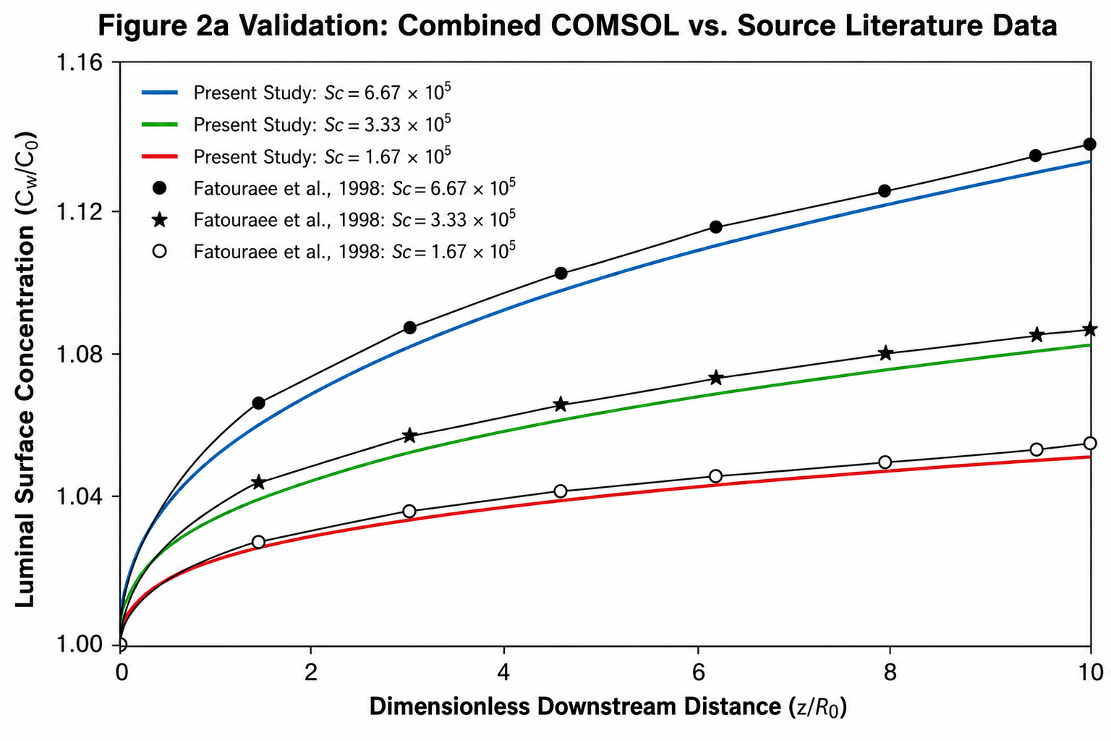
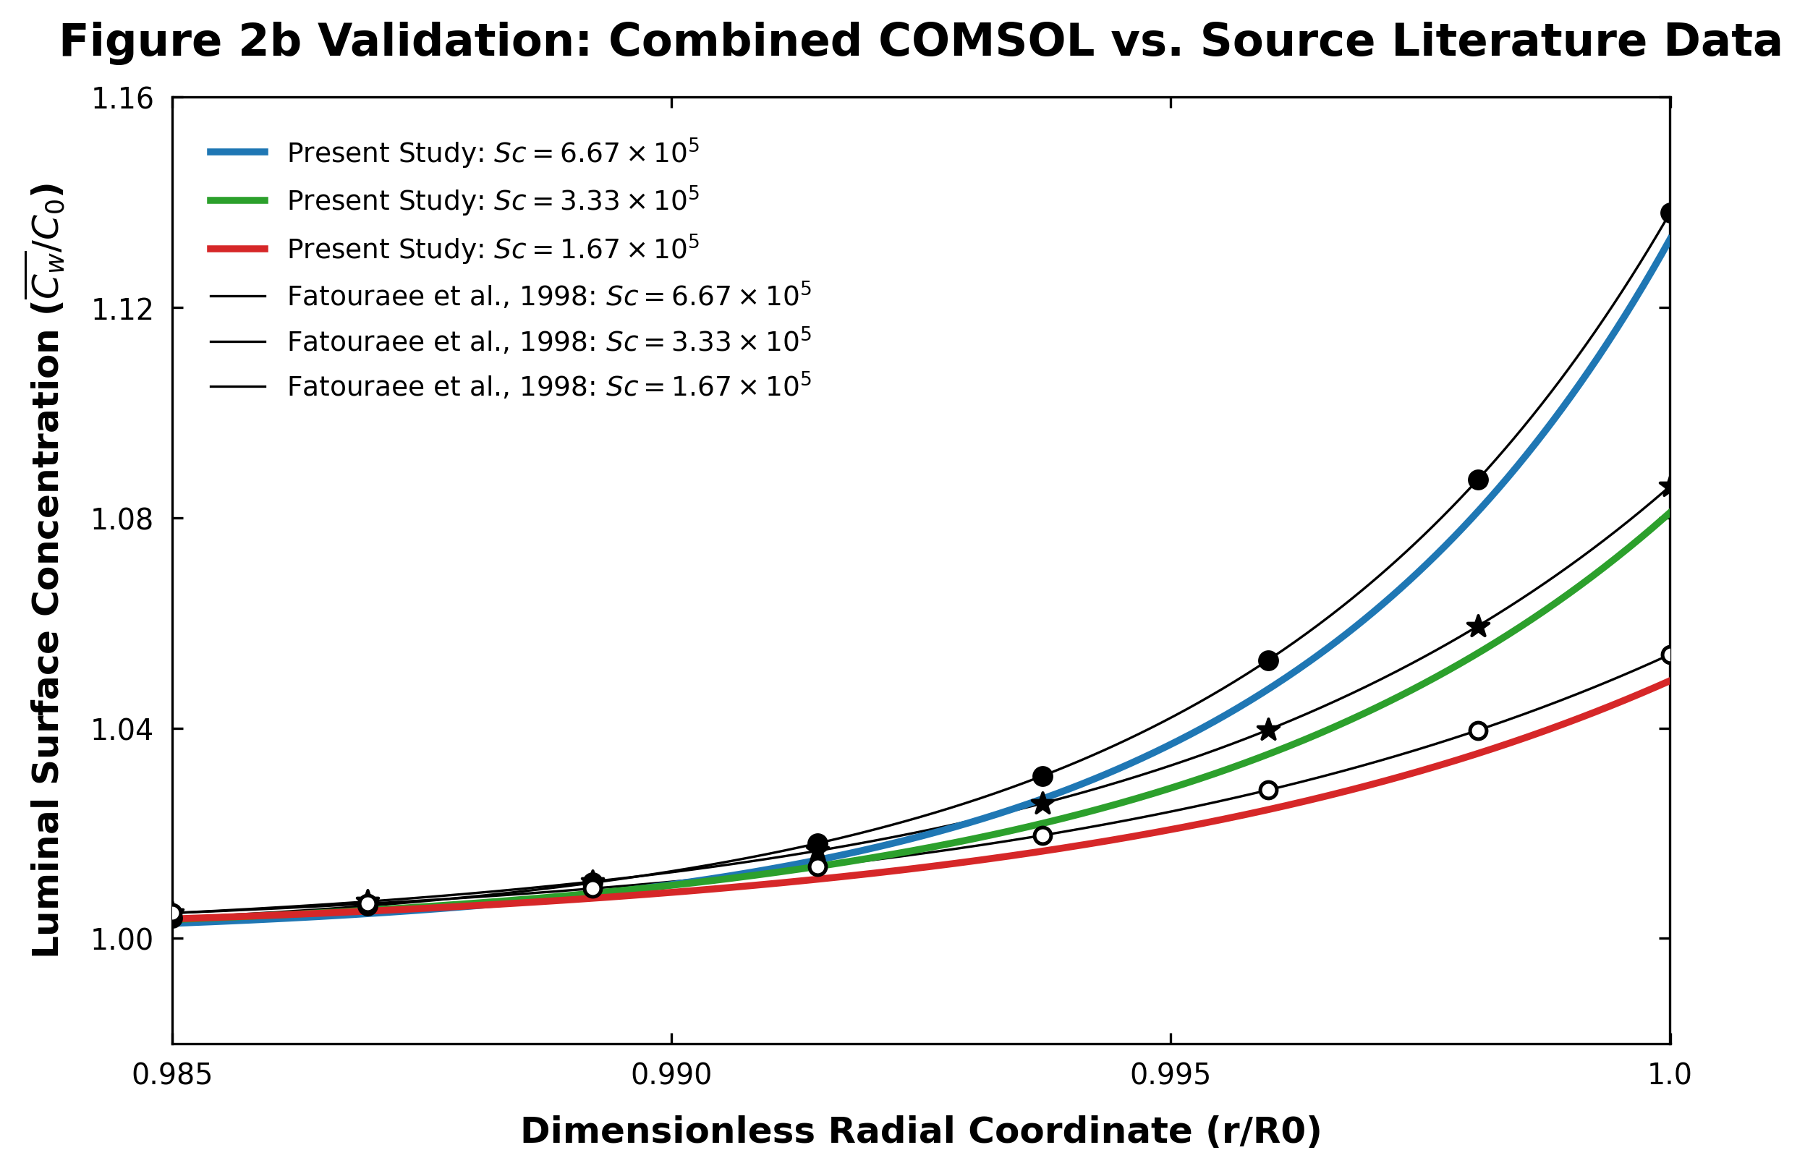
Results: Steady-State LDL Concentration Profiles
Time-averaged normalised luminal surface LDL concentration (V_{w} = 4×10⁻⁶ cm/s)
Fig. 2a — Axial distribution (z/R₀)
Fig. 2b — Radial distribution near wall (zoomed)

Slide 8
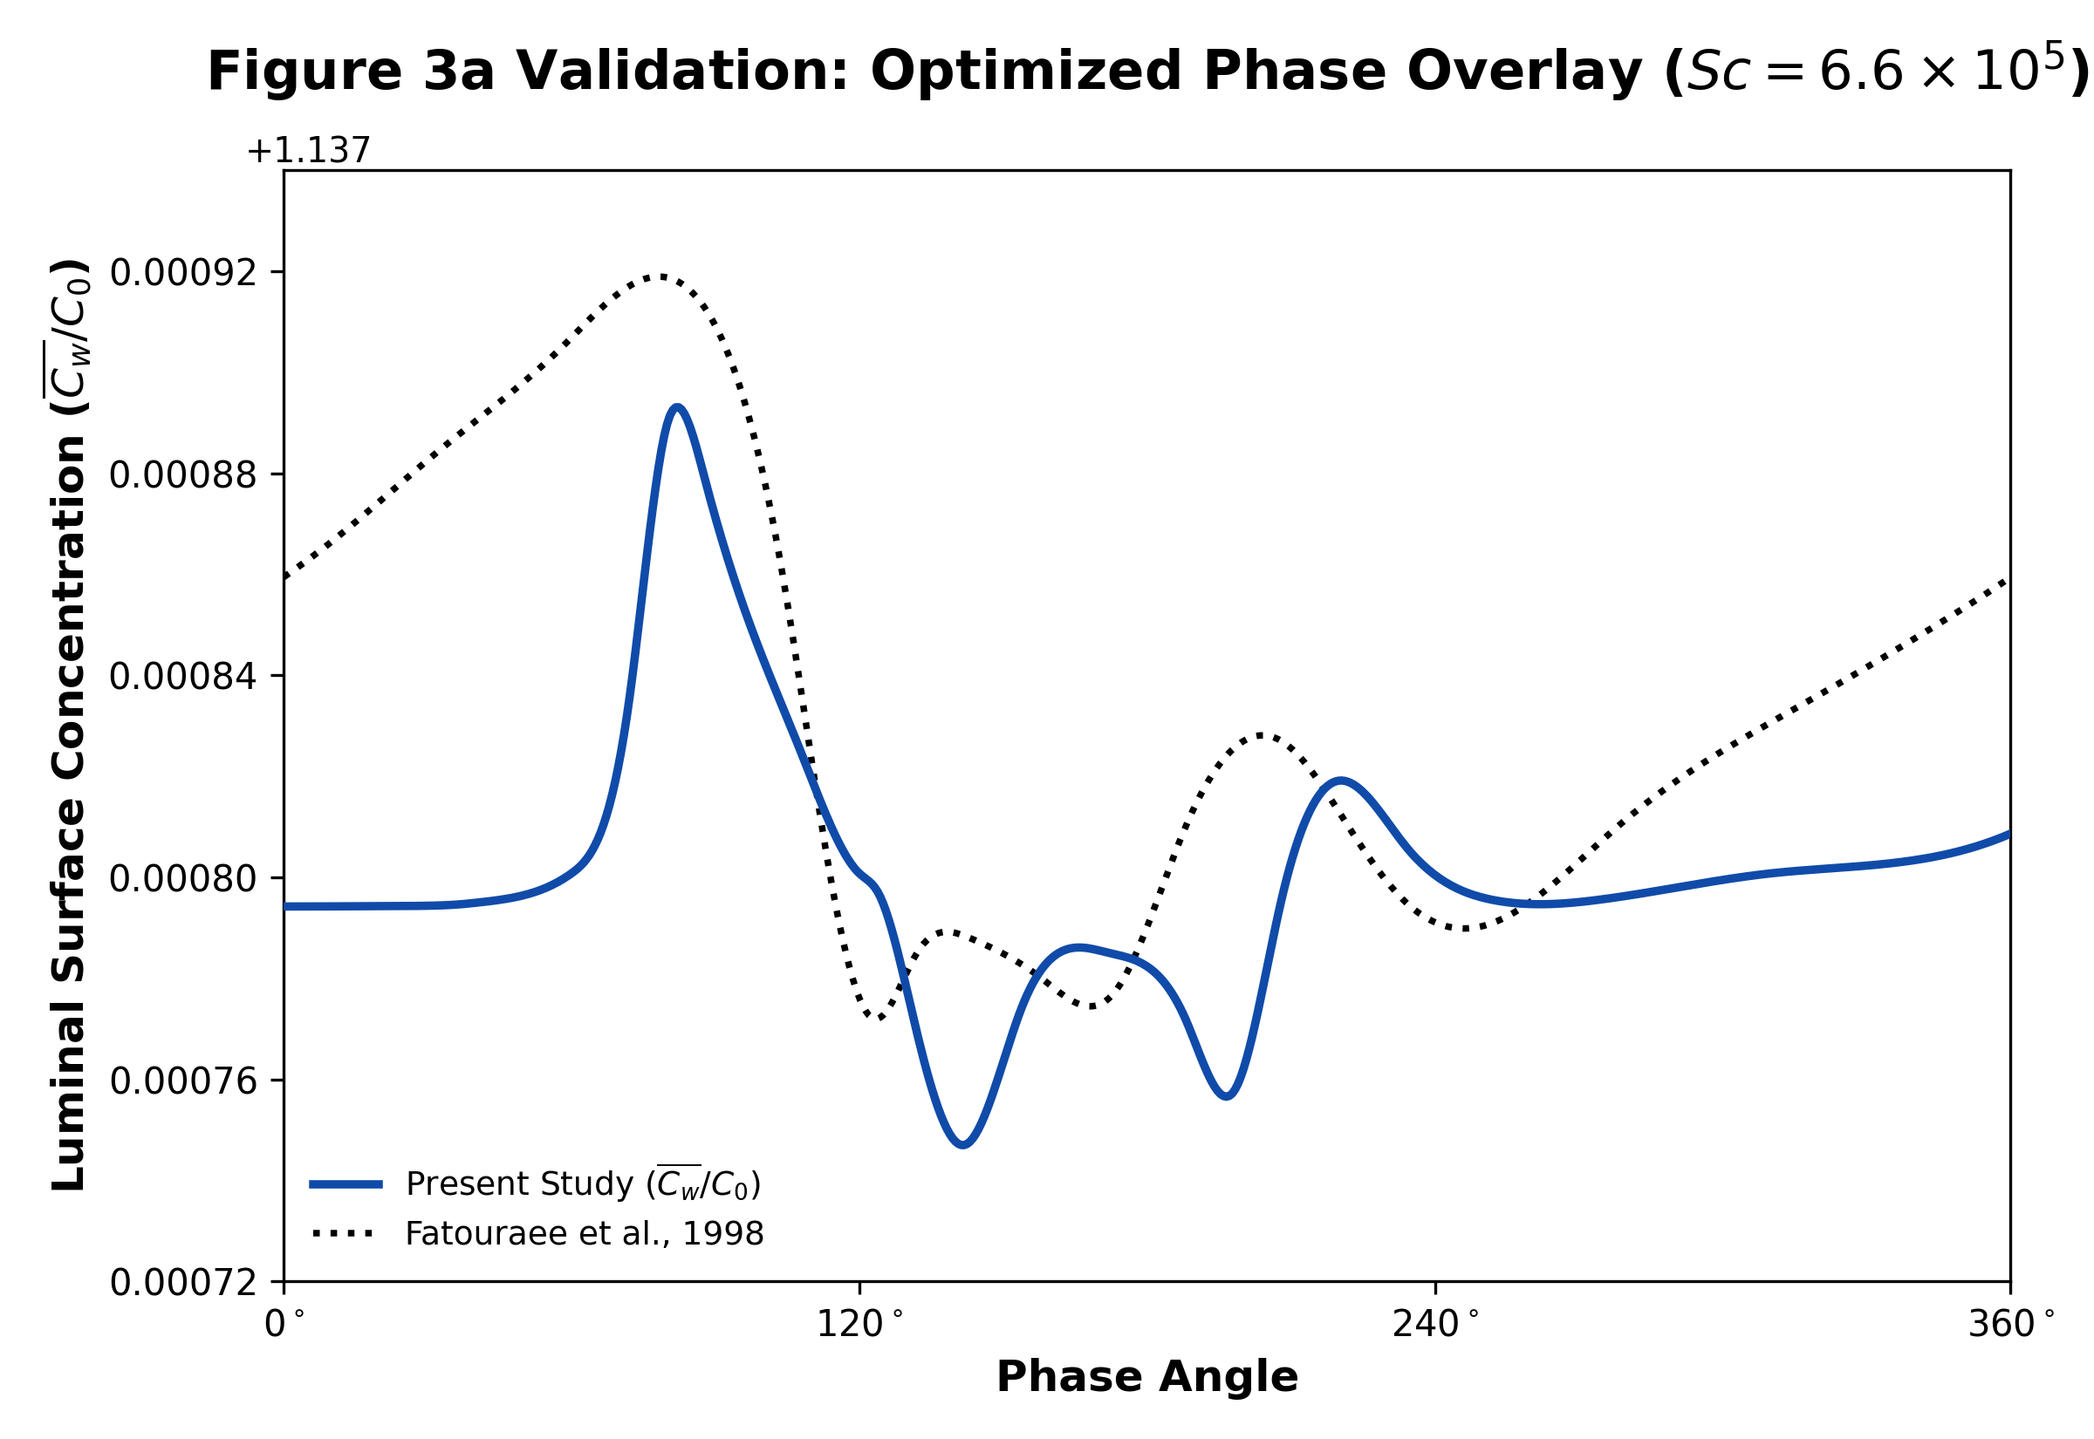
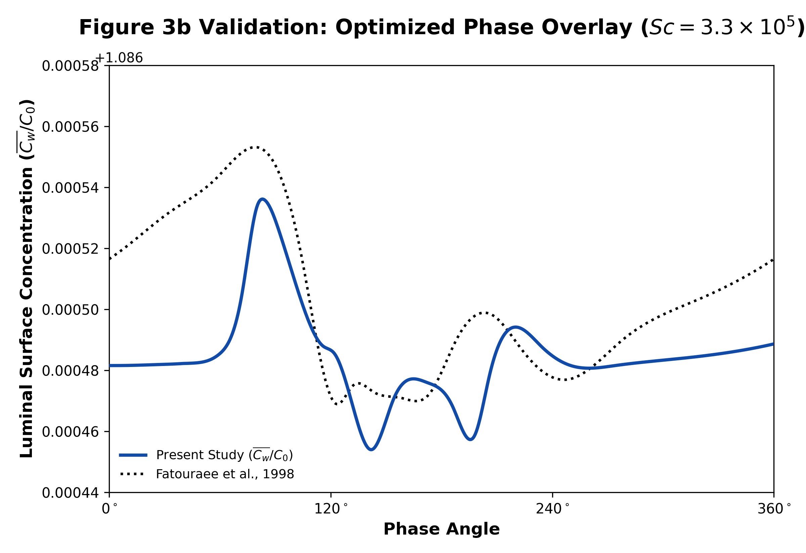
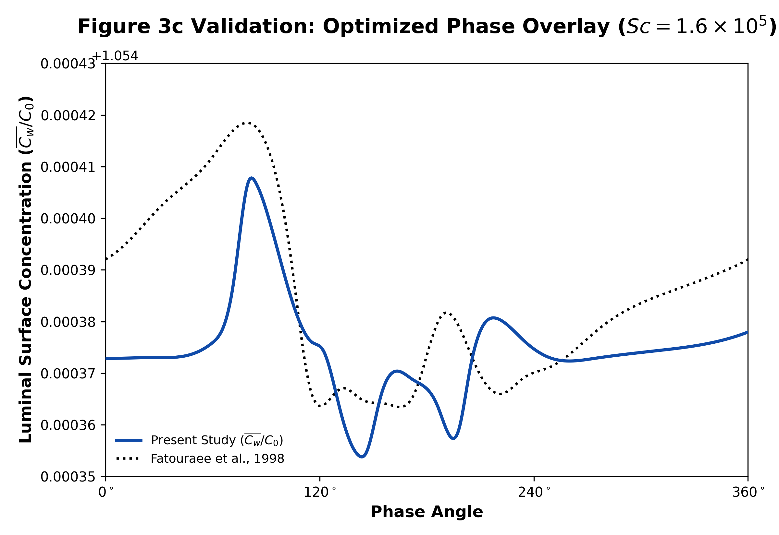
Results: Pulsatile Flow — Steady Periodic State (Fig. 3)
C_{w}/C₀ vs phase angle over one cardiac cycle (V_{w} = 4×10⁻⁸ m/s)
Fig. 3a — D = 5×10⁻¹² m²/s (Sc = 6.6×10⁵)
Fig. 3b — D = 1×10⁻¹¹ m²/s (Sc = 3.3×10⁵)
Fig. 3c — D = 2×10⁻¹¹ m²/s (Sc = 1.6×10⁵)

Slide 9
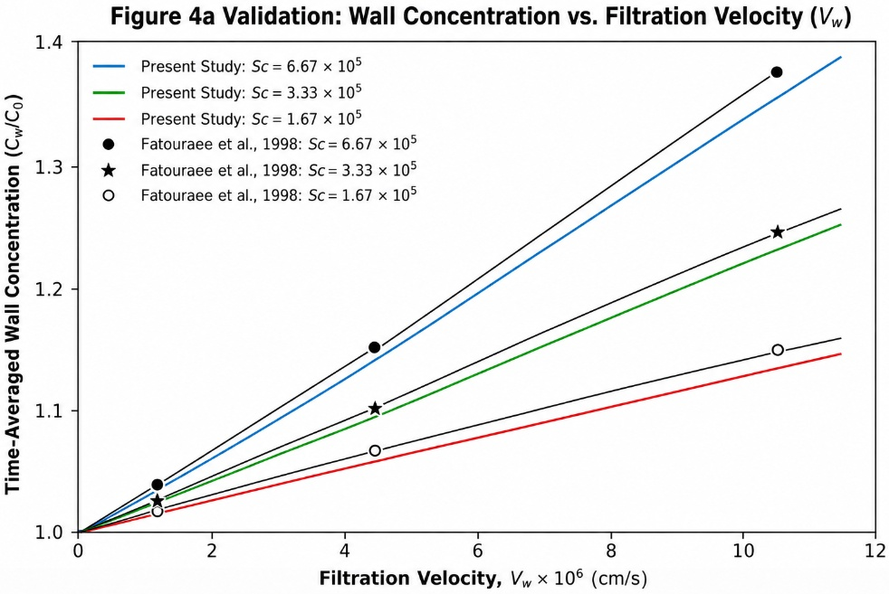
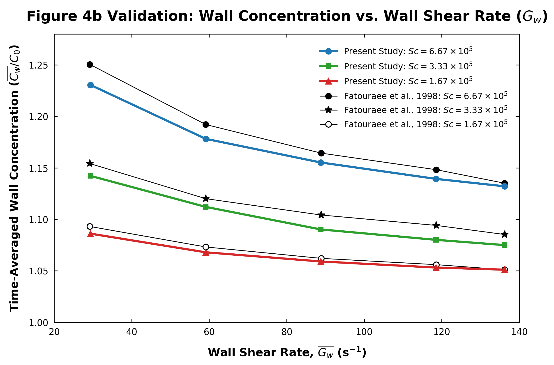
Results: Effect of Filtration Rate & Wall Shear Rate on C̄w/C₀
Time-averaged normalised wall LDL concentration vs. V_{w} and wall shear rate G̅_{w}
Fig. 4a — C̄_{w}/C₀ vs filtration rate V_{w} (linear increase)
Fig. 4b — C̄_{w}/C₀ vs wall shear rate G̅_{w} (inverse relationship)

Slide 10
Key Findings
Concentration polarization of LDL is confirmed under both steady-state and pulsatile flow; time-averaged luminal LDL concentration is 5-14% above bulk concentration.
Axial C̄_{w}/C₀ increases along the artery, with a steeper rise at higher Schmidt numbers.
Radial C̄_{w}/C₀ remains nearly uniform in the core flow but rises sharply near the wall, forming a concentration boundary layer.
Pulsatile flow causes periodic fluctuations in LDL concentration.
C̄_{w}/C₀ increases linearly with filtration rate through the vessel wall.
C̄_{w}/C₀ decreases inversely with wall shear rate, indicating highest LDL accumulation at low-shear regions.
Pulsatility raises time-averaged surface concentration slightly above the steady-flow value.
Results support regional LDL accumulation as a mechanism for atherosclerosis localization.

